Slide 1
Salesforce CPQ Solution catering an E commerce system

Slide 2
CPQ solution for E Commerce Scenario:
The solution that is charted down can be used for almost all generic B2B processes helping them manage their relationships with existing and potential customers subject to some business specific changes based on the products involved.
This solution will involve creation and capturing of a prospect customer through various channels like web source, media, campaigning, door to door sales, etc.
Engaging this prospect customer as well as existing customers with promotional offers and keeping them up to date with the latest offerings.
Following up with this customer based on their assigned territories.
Taking this customer into the Sales stream and order fulfilment through the quoting process thereby eventually invoicing them for the services/products sold.

Slide 3
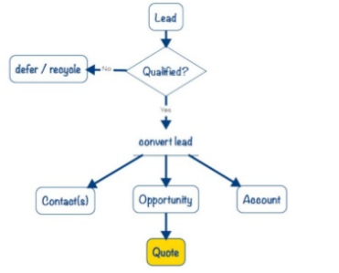
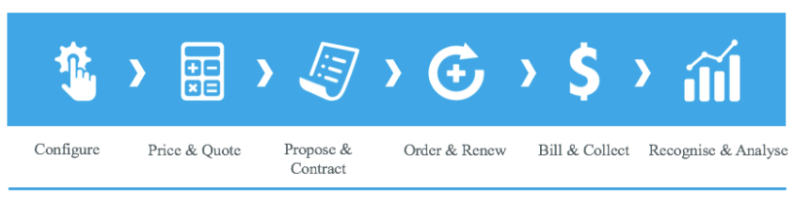
Lead to Quote to Cash cycle ( L-Q-C )

Slide 4
L-Q-C flow details
A Pre lead/ lead will be stored as a record in CRM once the CRM environment is integrated with the Customer service centre, Official vendor website, media sources, etc.
This lead after crossing the threshold percentage qualifier will be qualified as an account, contact and an opportunity capturing the basic details of the prospect customer for quote proposal.
The opportunity will be then used for Quote/ Proposal creation where CPQ tools such as SFDC CPQ, APTTUS, PROS are used frequently.
The CPQ tool will be responsible for the Catalogue/ Product management, Constraint Rule management, Price Management, Quote Proposal management ( CLM tools ), Approval and Workflow management which will help the sales representative sell correct and sell better.
Quote configured in the CPQ tool will be sent via email to the customer for signing/acceptance and subsequently this quote will involve various quote versions, the accepted quote will be set as primary quote.

Slide 5
The opportunity created will be closed and the account will hold the asset lines/ installed bases.
A contract will be created based on the terms and conditions specified in the sent quote consisting of a start date and end date.
This contract will be used for order creation and subsequent delivery and invoicing ( ERP integration )
The contract when nearing its termination date ( 1 month prior to termination ), the sales representative will get notified to create the renewal opportunity and renewal quote which will again be sent to the customer with renewed prices ( Mark-up amount ) and renewed contract dates along with renewed terms of use.
The asset line items created will be used for creation of forecasting models for the vendor.
This will in turn help the organization to stay updated with the market demand and supply and not lose any revenue.

